Slide 1
LT.UAYCHAI PHOTHONG
IHO – NIPPON FOUNDATION
ALUMNI SEMINAR
Thailand

Slide 2
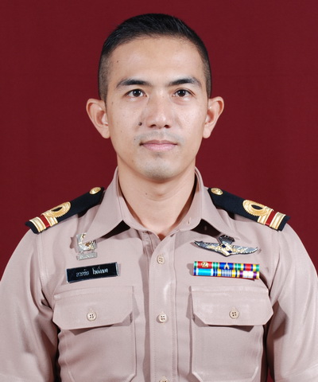
Self introduction
IHO – NIPPON FOUNDATION
ALUMNI SEMINAR
Name | LT.UAYCHAI PHOTHONG
Alumni year | 2013
Country | Thailand
Organization | Hydrographic Department, Royal Thai Navy.
Position/Job title | Attached to ENC section , Cartographic Division, HDRTN.
Current job description | Create and maintain ENCs and Nautical charts in Thai’s water.
Please put your photo here!

Slide 3
My career path and projects / Achievements
IHO – NIPPON FOUNDATION
ALUMNI SEMINAR
1998 Naval Rating School, Royal Thai Navy.
(Engineering Line, Engine corps.)
2000 Engine corps, HTMS.SURIYA, HDRTN.
2002 Engine corps, HTMS.SUK, HDRTN.
2004 Cartographer, Nautical Chart Section, Cartographic Division,
HDRTN.
2011 - 2019 Attached to ENC Section, Cartographic Division, HDRTN.

Slide 4
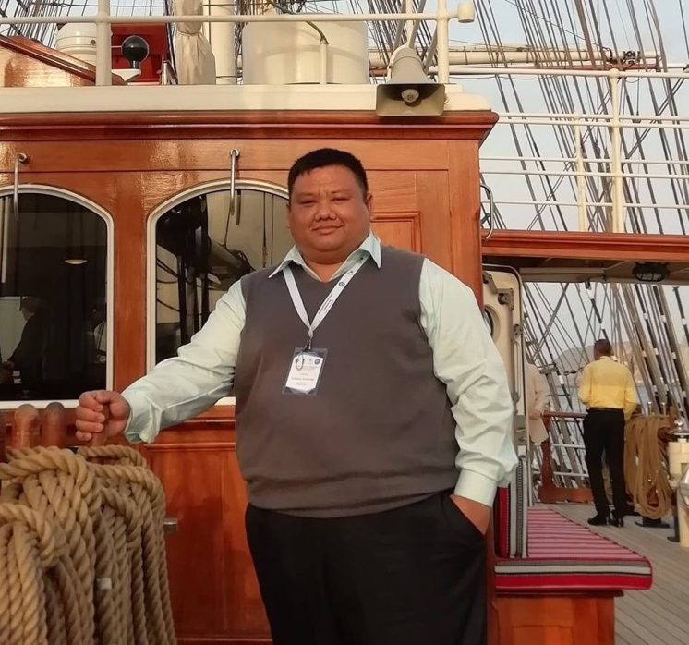
IHO – NIPPON FOUNDATION
ALUMNI SEMINAR
Thailand IHO – Nippon Foundation alumni
Name | CAPT.RITTIDATE KATETONG
Alumni year | 2010
Position/Job title | Deputy director of Cartographic Division, HDRTN.
Name | LCDR.AREE HWANLABEH
Alumni year | 2017
Position/Job title | Head of Operational Chart Section, Cartographic Division, HDRTN.

Slide 5
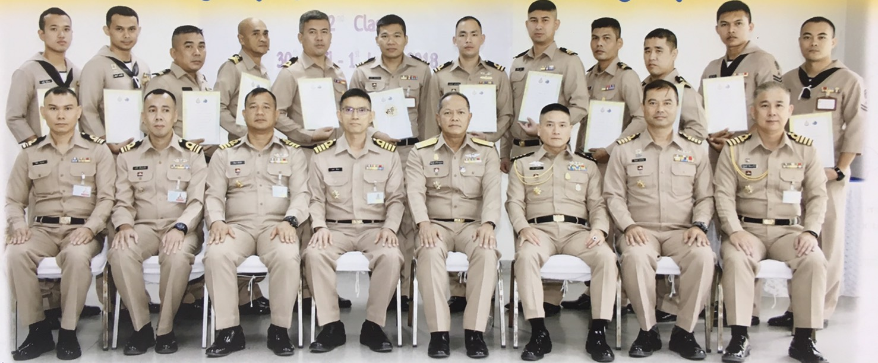
Lessons learned from CHART Course
IHO – NIPPON FOUNDATION
ALUMNI SEMINAR
Marine Cartography: Pass on knowledge to the new cartographers and various department
“Basic Cartography Course for Cartographer 2nd class” in 2018

Slide 6
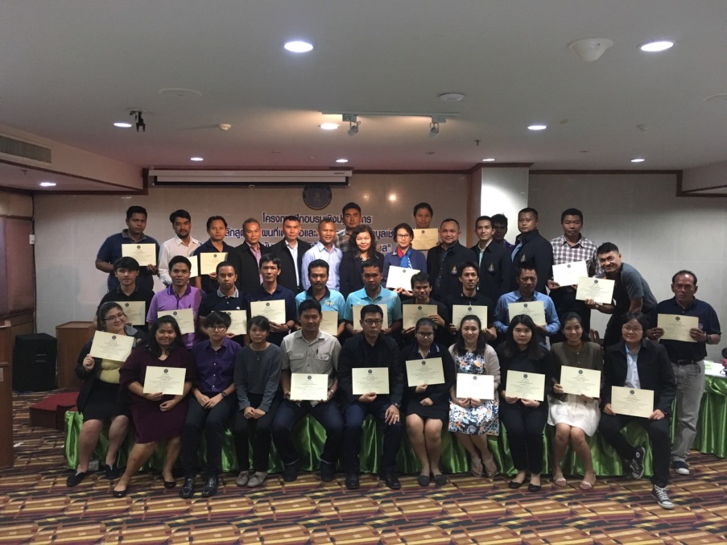
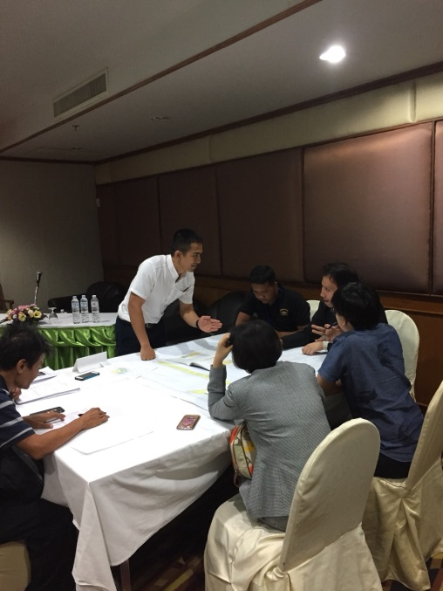
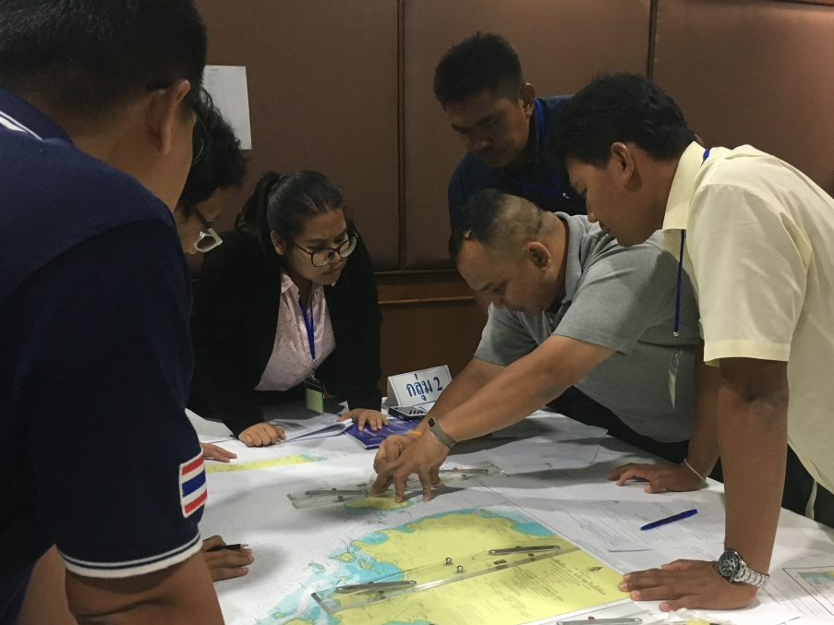
Lessons learned from CHART Course
IHO – NIPPON FOUNDATION
ALUMNI SEMINAR
Cooperation with Department of Fisheries, Ministry of Agriculture and Cooperatives.
“Nautical Chart and Basic Plotting”

Slide 7
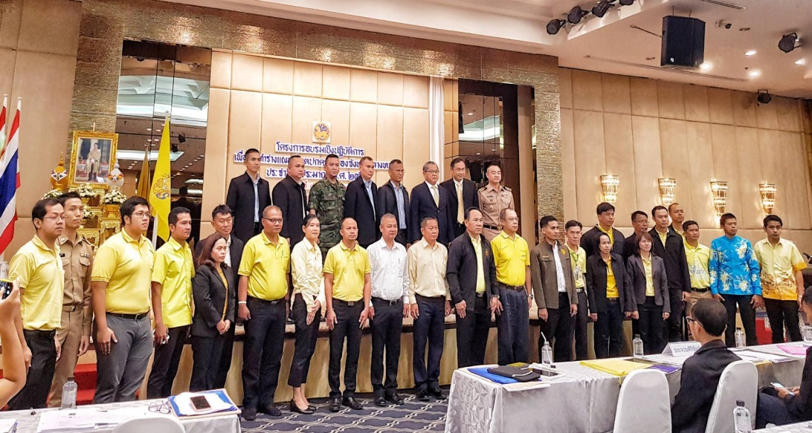
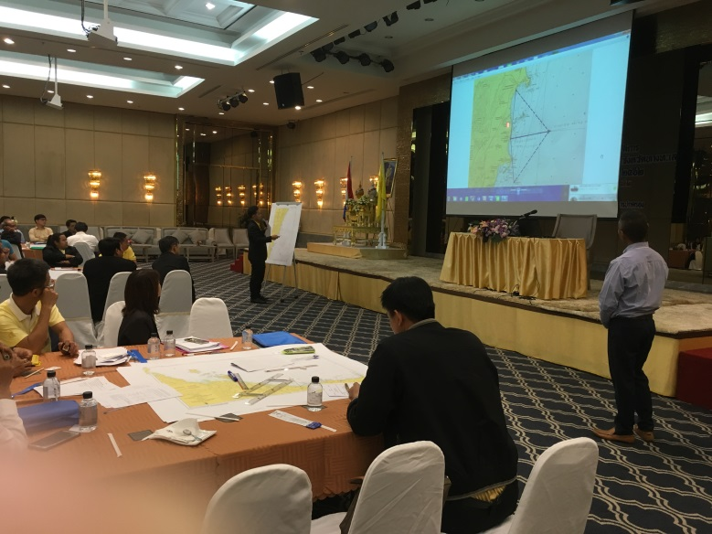
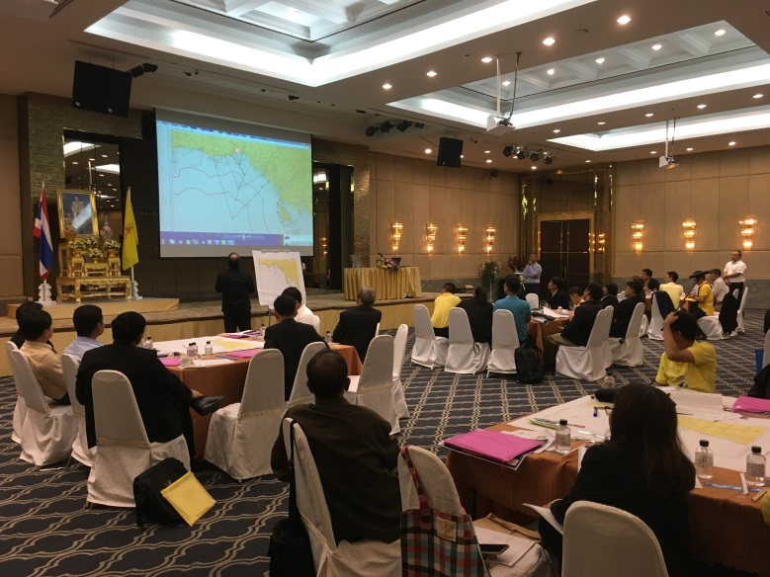
Lessons learned from CHART Course
IHO – NIPPON FOUNDATION
ALUMNI SEMINAR
Cooperation with Department of Provincial Administration.
“Marine boundary and Nautical Chart Foundation”

Slide 8
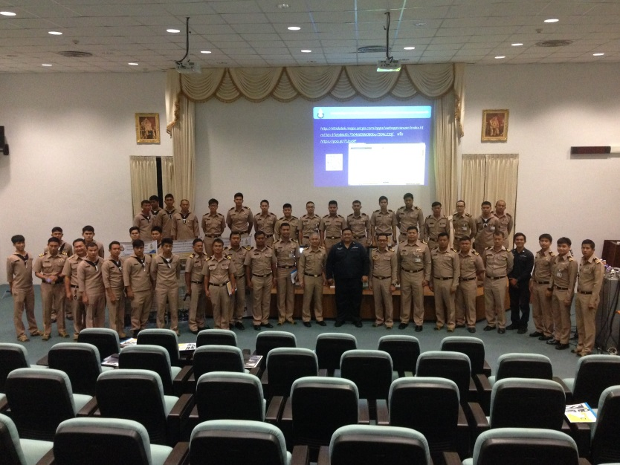
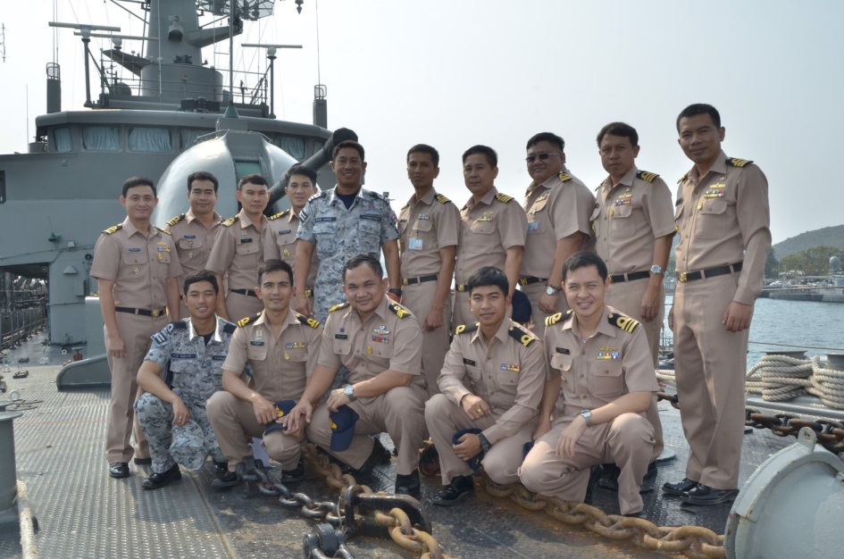
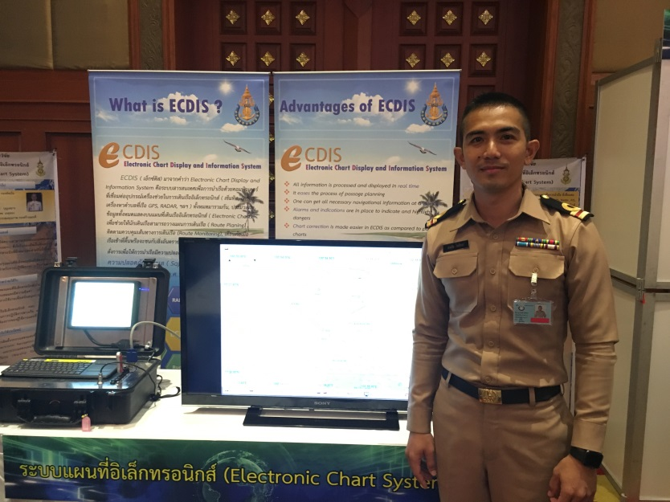
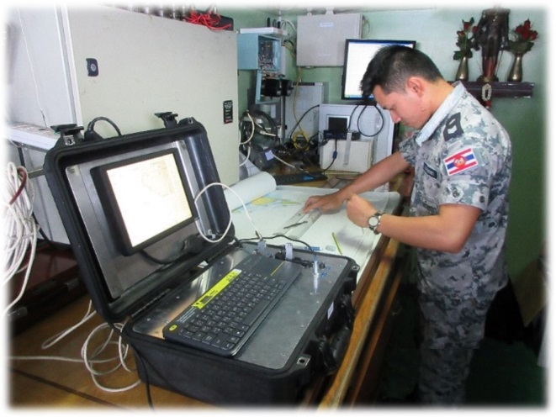
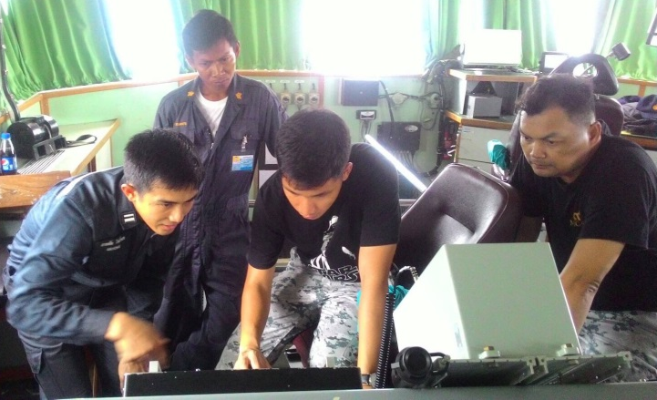
Lessons learned from CHART Course
IHO – NIPPON FOUNDATION
ALUMNI SEMINAR
Research Project for Electronic Chart System (ECS) to Royal Thai Navy Fleet.
Researcher : CAPT.RITTIDATE KATETONG

Slide 9
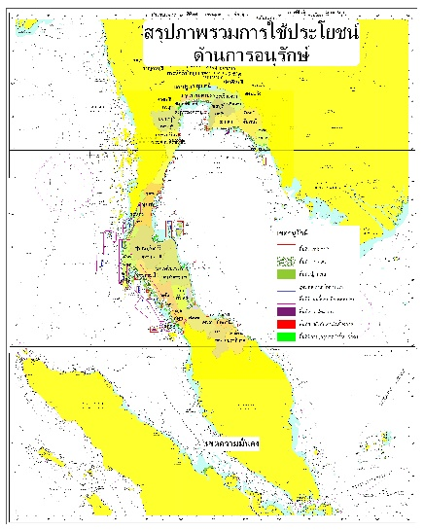
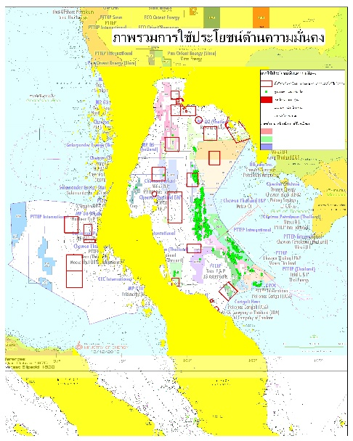
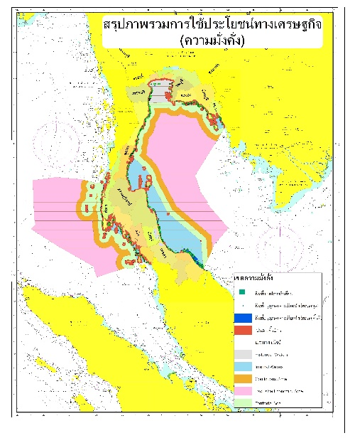
Lessons learned from CHART Course
IHO – NIPPON FOUNDATION
ALUMNI SEMINAR
Implement Hydro Spatial Data
Infrastructure for the Beginning of
Thailand MSDI.

Slide 10
Suggestion for the future
IHO – NIPPON FOUNDATION
ALUMNI SEMINAR
Online Help desk for alumni to Q&A and share information for chart production.

Slide 11
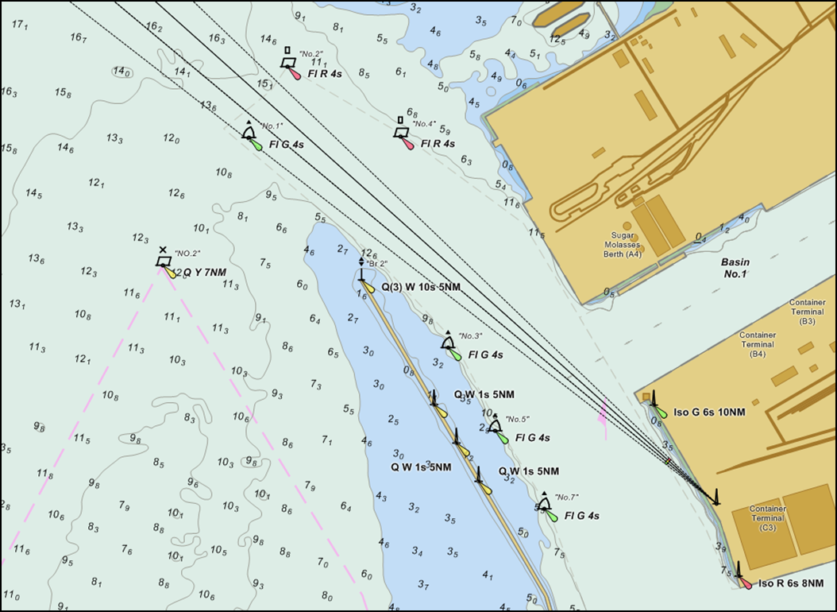
Thank you

